Slide 1
Federal Workers’ Compensation:
Basic Representation
Field Services and Education Department
American Federation of Government Employees

Slide 2
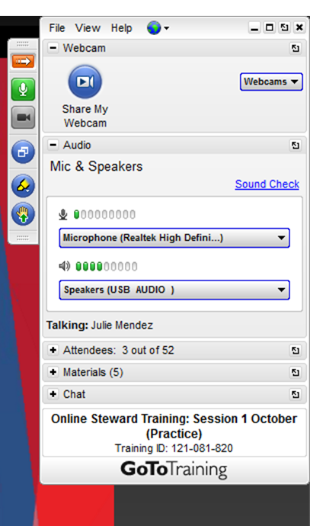
Virtual Control Panel
Side Menu Icons
  Hide/Unhide
  Microphone Mute
  Drawing Pen/Highlighter
  Raise Your Hand
Main Menu Sections
  Audio
  Attendees
  Materials
  Chat

Slide 3
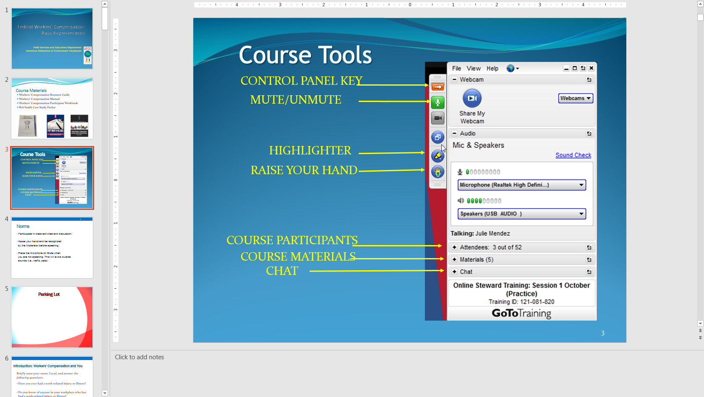
Online Protocol
Use a headset or earbuds to prevent echo through your speakers.
Place the microphone/phone on Mute when you are not speaking. This will avoid outside sounds (i.e., traffic, pets).
Raise your hand and be recognized by the Moderator before speaking.
Participate in class activities and discussion.

Slide 4


Course Materials
Workers’ Compensation Resource Guide
Workers’ Compensation Manual
Workers’ Compensation Participant Workbook
Bob Smith Case Study Packet

Slide 5

Parking Lot

Slide 6
Introduction: Workers’ Compensation and You
Briefly state your name, Local, and answer the following questions:
Have you ever had a work-related injury or illness?
Do you know of anyone in your workplace who has had a work-related injury or illness?
Have you ever helped someone with a workers compensation claim?

Slide 7

Objective
At the end of this course, you should be able to:
Assist members in filing a Workers’ Compensation claim if they become injured or ill due to a work-related activity.

Slide 8
How can a Workers’ Compensation Representative help members?
Notes:
Whiteboard Activity

Slide 9
Workers’ Compensation Representative
Serve as an advocate for the members.
Educate members on their rights and responsibilities.
Understand management’s responsibilities in the claims process.
Assist members in the completing forms and responding to agency and OWCP requests for information.
Assist members in obtaining the appropriate medical reports from physicians.

Slide 10
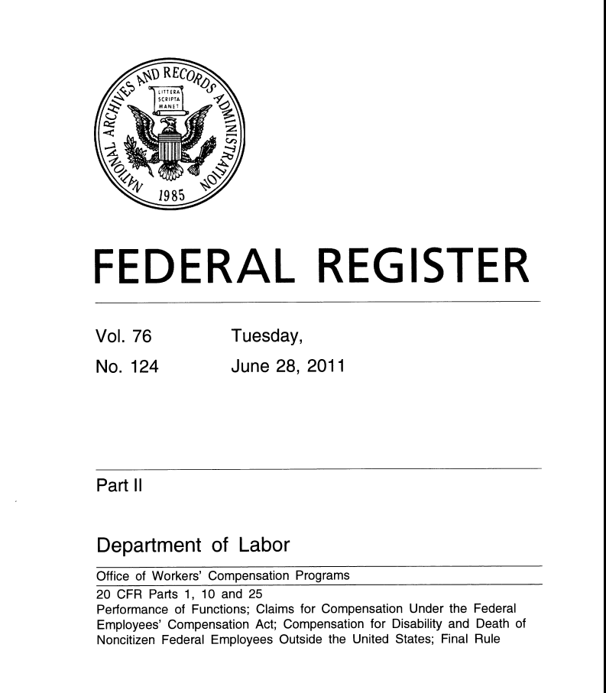
Representation and the Regulation
What do the regulations say about workers’ compensation claim representation?
Identify where in the regulation it describes the requirements for representing an employee workers’ compensation claim.
Page:
Section
Notes:
Whiteboard Activity

Slide 11

Representation and the Regulation
10.700 May a claimant designate a representative?
… a claimant may appoint one individual to represent his or her interests, but the appointment must be in writing.
10.701 Who may serve as a representative?
A Federal employee may act as a representative only:
(b) While acting as a union representative, defined as any officially sanction union official, and no fee or gratuity is charged.
Resource Guide
Page 34
Subpart H-Special Provisions
Notes:
Whiteboard Activity

Slide 12

Workers’ Compensation Overview
Federal Workers’ Compensation Law and Regulation
Benefits
Conditions of Coverage

Slide 13
Federal Employees’ Compensation Act (FECA)
Federal Employees’ Compensation Act (FECA) passed in 1916
Administered through the U.S. Department of Labor (DOL)
Office of Workers Compensation Programs (OWCP)
Division of Federal Employees’ Compensation (DFEC)
Non-adversarial
Exclusive Remedy
Notes:
Whiteboard Activity

Slide 14

What Was the Reaction of Labor Unions to Workers’ Compensation Legislation?
Notes:
Whiteboard Activity

Slide 15
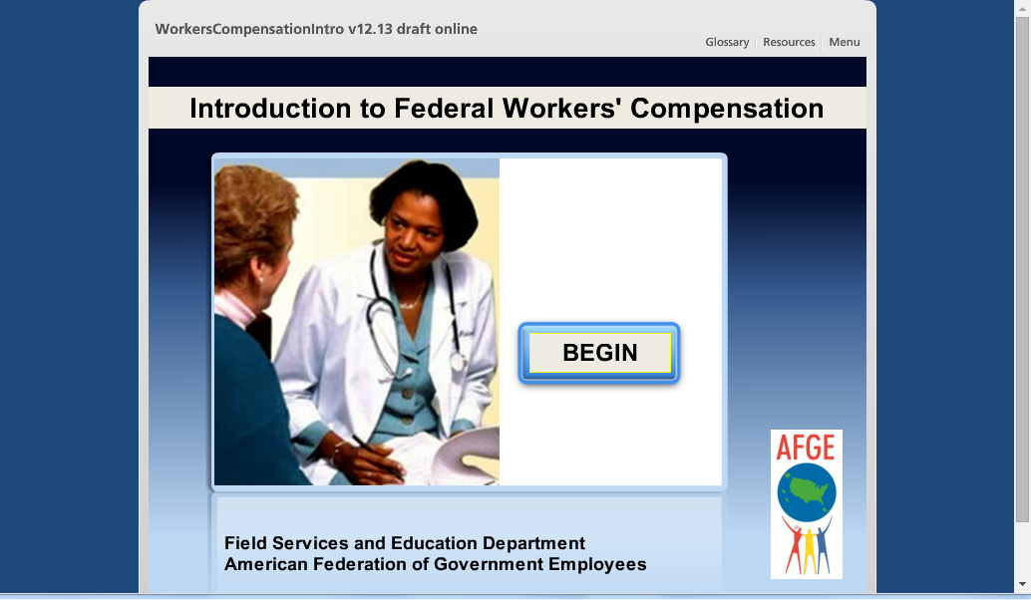
FECA Benefits and Conditions www.afge.org/healthsafety

Slide 16
Schedule Award
Member | Weeks | Member | Weeks
Arm | 312 | Loss of Hearing (one) | 52
Leg | 288 | Loss of Hearing (both) | 200
Hand | 244 | Breast | 42
Foot | 205 | Kidney | 156
Eye | 160 | Larynx | 160
Thumb | 75 | Lung | 156
First Finger | 46 | Penis | 205
Great Toe | 38 | Testicle | 52
Second Finger | 30 | Tongue | 160
Third Finger | 25 | Ovary/Fallopian Tube | 52
Toe | 16 | Uterus/Cervix | 205
Fourth Finger | 15 | Vulva/Vagina | 205

Slide 17

Causal Relationship
Link between work-related exposure and medical condition being claimed
Four Types
  Direct Causation
  Aggravation
  Acceleration
  Precipitation

Slide 18

How Would OWCP Handle A Service-Related Medical Condition?

Slide 19
How Would OWCP Handle A Service-Related Medical Condition?
A Marine Corps veteran with a 10% disability in his left shoulder is hired by the Department of Veterans Affairs. After three years on the job as a nurse, he reinjures his shoulder while working. His physician states that as result of the injury, he now has a 25% disability.
What percentage of the disability will the Office of Workers’ Compensation cover?

Slide 20
Statutory Exclusions
Willful Misconduct
Drug or Alcohol Intoxication
Intent to Injure Self or Others

Slide 21
Covered or Not Covered?
Scenario 1: A Veterans Administration nurse is moving a patient and injures her back. She immediately notifies her supervisor. She has no witnesses who saw the injury occur on working hours.

Slide 22
Covered or Not Covered?
Scenario 2: A Social Security retiree files a claim for workers compensation for an injury that he incurred five years before when working in a warehouse while on duty.

Slide 23
Covered or Not Covered?
Scenario 3: A Coast Guard employee complains of a sprained ankle received when he slipped on a section of ice on the sidewalk outside the office.

Slide 24
Covered or Not Covered?
Scenario 4: A retired DOD civilian employee is diagnosed with asbestosis. It appeared that he contracted the disease when working on asbestos insulation at a military base.

Slide 25

Types of Claims and OWCP Forms

Slide 26

Claims and Forms
Traumatic Injury
Occupational Disease
Recurrence
Compensation and Medical Forms

Slide 27
Traumatic Injury
Injury caused by specific event or series of events occurring during one work shift.
Eligible for Continuation of Pay (COP)
CA-1: Notice of Traumatic Injury
CA-16: Authorization for Examination

Slide 28
Break Room Activity
Room 1: CA-1
Identify the line on the form:
Where the description of the injury occurred should be written.
Where the description of the cause of the injury should be written.
Where they can choose to use COP.
Room 2: CA-16
Identify the line on the form:
Where is the description of the injury or disease written?
Where does the physician state that the condition was caused or aggravated by employment?
Where should the physician sign the document to verify all the statements on the form?

Slide 29
CA-1: Notice of Traumatic Injury
Employees: Complete and send in ASAP.
Two Parts
  Employee (Front)
  Supervisor or Human Resources (Back)
Select COP or use leave.
Agency must send to OWCP within 10 workdays from date they receive the form.

Slide 30
COP: Basic Requirements
Only for Traumatic Injury events
Injury must be reported on CA-1 within 30 days.
Prima facia medical evidence must be provided within 10 calendar days from the date of filing.
Disability has to begin within 45 days after injury event (not including the day of injury).

Slide 31
CA-16: Authorization for Examination/Treatment
Issued to employee within four hours of injury. Verbal authorization can be given; issue within 48 hours.
Not required after one week.
Guarantees payment of non-invasive treatment or examination for 60 days.

Slide 32
Questions to Consider
A co-worker severely injures their leg while in the performance of duty. The doctor states that they will not be able to return to work until at least 60 days following surgery.
What happens after COP expires?
What steps would you recommend the worker take to make sure they receive wage-loss disability payments?
Who will make the payments?

Slide 33
Questions to Consider
§ 10.111 What should the employer do when an employee files an initial claim for compensation due to disability or permanent impairment?

Slide 34
Occupational Disease
Condition produced over a period longer than one work day or work shift.
Examples include repetitive motion disorder, asbestosis, silicosis, etc.
Not eligible for COP.
CA- 2: Notice of Occupational Disease
CA-35 (a-h) Occupational Disease Checklist

Slide 35
Breakout Room Activity
Room 1: CA-2
Identify the line on the form:
Where the employee should describe the nature of the disease or illness.
Where the supervisor describes the date and hour the employee stopped working.
Where the supervisor can describe new duties, if the work assignment has changed.
Room 2: 35a-h
Identify which form:
Serves as a checklist for information that should be provided with a CA-2.
Should be completed if an employee has wrist problems due to the job.

Slide 36
CA- 2: Notice of Occupational Disease
Two parts:
  Employee completes the front
  Supervisor or HR completes the back
Must be transmitted to OWCP within 10 workdays.

Slide 37
CA-35 (a-h)
Occupational Disease Checklist
Lists information required from both employee and supervisor
Specific forms for seven different conditions and general occupational disease

Slide 38
Question to Consider
A TSA employee is diagnosed with arthritis and the doctor states that their job duties are aggravating the condition.
What form(s) should the employee file for this situation?

Slide 39
Recurrence
Recurrence of Medical Condition
  Documented need for additional medical treatment after release from treatment for the original condition.
  No accompanying work stoppage.
  Continuing treatment for the original condition is not considered a reoccurrence.
Recurrence of Disability
  Inability to work due to several conditions.

Slide 40
Recurrence of Disability
Spontaneous return of symptoms of the original injury, illness or disease without an intervening incident.
Disability due to the consequence of the original injury, illness or disease.
  Example: Fall caused by weak knees damaged by an earlier work-related injury.
Inability to work when a light-duty assignment for work-related injury or illness is withdrawn or requirements exceed physical limitations.

Slide 41
CA-2a: Notice of Recurrence
Employee and employer required to complete various sections of the form.
If employee is no longer working for the Federal Government they should submit the information directly to OWCP.

Slide 42
Questions to Consider
A DOD worker injured their arm on the job three years ago. Following treatment, they have been symptom free for two years. In the last six months, the arm has begun to hurt again and the doctor states that it will require ongoing medical care but the employee can continue to work.
What type of claim is this- a recurrence of medical condition or a recurrence of disability?
On Form CA-2a, what line(s) of the form would state which type of recurrence has occurred?

Slide 43
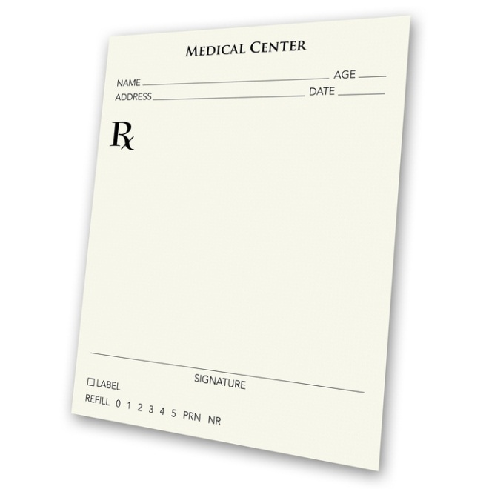
Compensation and Medical Forms
Common forms required for OWCP claims include:
CA-7: Claim for Compensation
CA-20: Attending Physician’s Report
CA-17: Duty Status Report

Slide 44
Breakout Room Activity
Room 1: CA-7
Identify the section(s) of the form:
Where the employee can ask for leave buy back.
Room 2: CA-20
Identify the line on the form:
Where the physician indicates what the diagnosis is for the medical condition
Where the physician states that the medical condition was caused or aggravated by an employment activity.

Slide 45
CA-7: Claim for Compensation
Note: Not used for compensation during the 45 day COP period under traumatic injury events.
When to file:
  Wage loss compensation: COP ends; LWOP starts and biweekly afterwards
  Leave buy back: within one year of date leave used or claim accepted, whichever is later (CA 7a and CA 7 b)
  Schedule award: maximum medical improvement (MMI)
Agency must send to OWCP within five (5) workdays.

Slide 46
CA-20: Attending Physicians Report
Submitted to OWCP along with CA-7 for wage loss or leave buy back
Requests information on:
  Diagnosis
  Prognosis
  History of injury
  Prima facie statement of causal relationship, etc.

Slide 47
CA-17: Duty Status Report
Provides OWCP and Agency with medical report about the employee’s ability to work
Agency can send to physician at anytime during life of claim

Slide 48
Submitting Forms to OWCP
U.S. Department of Labor, DFEC Central Mailroom, P.O. Box 8300, London, KY, 40742-8300.
Employees’ Compensation Operations and Management Portal
www.ecomp.dol.gov/#
Notes:
Go to virtual tour.

Slide 49
Getting through the Process:
Selecting and Completing OWCP Forms

Slide 50
Case Studies – OWCP Forms
See Participant Workbook – page 8-9 (OWCP Worksheet)
Covered Under FECA?
Injury or Illness?
What forms apply?
What specific timeline or deadlines may affect processing this claim?

Slide 51
Initial Reports
Bob McDonald – DOD Employee
Fell down and hurt myself while walking. Had to leave a work meeting to go to the doctor.
Sallie Atwood – USDA
I have problems using my right hand due to numbness in my fingers. I am an inspector for the USDA.

Slide 52
Bob McDonald – DOD
I am a civilian employee for the Air Force stationed at the Pentagon in Washington, DC. I was walking in the corridor outside Room 303 on December 15, 2011 at 12:30 pm on the way to a meeting called by my supervisor on RIF procedures. I slipped on a wet area of a recently cleaned tile floor and fell hard on my back and shoulder. I twisted to try to break my fall and my back, right hip, right hand and shoulder hit the floor first. A maintenance worker, Tim Shields heard me fall and came out of Room 303 to help me when I was on the ground. I had intense pain in my back, right hip, right should and hand. My neck was sore from twisting quickly as I hit the ground. Tim helped me to my feet and I made my way to the meeting, but my co-workers saw me and excused me from the meeting to get medical treatment. I called my supervisor to inform him of the situation while a co-worker, Sally Munger drove me to the clinic.
Received medical treatment for minor sprain to right arm on December 15 and was able to return to work on December 17.
FECA coverage:
Type of Injury:
Forms required:

Slide 53
Sallie Atwood– USDA
I am a USDA Food Inspector stationed in Omaha, Nebraska. I have worked for the last 15 years inspecting chickens at the All American Poultry plant in Omaha, Nebraska. On August 20, 2012 I saw my physician, Dr. Xi Oh, regarding problems with my right hand. I have significant numbness and weakness in my right hand at the thumb, index finger, and middle ring finger. At work, I repeatedly use the same hand movements to inspect the birds after they are rinsed in cold water and coolant. Dr. Oh diagnosed my condition as work-related carpel tunnel syndrome after I demonstrated my inspection process.
Doctor Oh confirmed the diagnosis using positive determinations based on Phalen’s test and Tinel’s Sign test, for work-related carpel tunnel syndrome. Treatment consists of four weeks of rest, with oral cortesteroid treatment in the first two weeks. Ms. Atwood will need to use a splint following her return to duty on September 24. Treatment and therapy will require approximately two 4-hour medical visits every three months.
FECA coverage:
Type of Injury:
Forms required:

Slide 54
SPECIAL CONSIDERATIONS
Light Duty Offers and the OWCP Appeals Process

Slide 55
Light Duty Offers
Can be made verbally but must be followed-up in writing
Must include: job description, physical demands of position, organizational and geographical location, date available, date response required
OWCP determines if appropriate
CA-17 Duty Status Report describes work limitations/restrictions by physician.

Slide 56
Appeal Process
Hearing
  Oral Hearing
  Review of Written Record
Reconsideration
Employees’ Compensation Appeal Board (ECAB)

Slide 57
Hearing or Review of Written Record
Can be an oral hearing or a review of the written record
  Oral hearing is an informal process. Telephone or at a location within 100 miles of employees home.
  Review of written record by hearing representative to go over official record and any additional information submitted.
Request within 30 days
Cannot request if already requested reconsideration.

Slide 58
Reconsideration by the District office
Written request within 1 year of the formal decision.
  Show that OWCP made a mistake or applied the law wrong
  Makes a new argument not considered by OWCP before
  Presents new evidence not previously considered by OWCP.

Slide 59
Employees’ Compensation Appeals Board (ECAB)
Must submit appeal to the Employees Compensation Appeals Board 180 days after formal decision.
Review of the official record used for formal decision.
Binding decision
Precedent-setting

Slide 60
Questions to Consider
An employee’s claim was denied because the physician did not include their medical opinion on the cause of the injury.
Two weeks after the employee received the denial letter, the physician agreed to provide his medical opinion with evidence stating that the injury was work-related.
What type of OWCP appeal, if any, would you file?
What type of appeal would not be appropriate for this case?

Slide 61
Researching OWCP Regulations

Slide 62
Activity: Regulation Research
Go to page 10 of the Participant Workbook.
Research the assigned questions using 20 CFR Part 10 found in the first tab of the Workers Compensation Resource Guide.
Write down the answer to your assigned question(s).
Include the section citation and the page number of where the answer is located.
Summarize the answer in bullet points, do not use the exact language of the regulation.

Slide 63
1. What information must the physician’s report include?
Section:
Page #:
Key points:

Slide 64
2. What criminal penalties are included in the FECA regulation?
Section:
Page #:
Key points:

Slide 65
3. What are the 3 types of appeals?
Section:
Page #:
Key points:

Slide 66
4. Under what circumstances can an Agency stop paying COP?
Page #:
Section:
Key points:

Slide 67
5. What happens when the OWCP doctor disagrees with your doctor?
Section:
Page #:
Key points:

Slide 68
6. How and when should medical report be submitted?
Section:
Page #:
Key points:

Slide 69
7. What should be included in a written job offer for a specific alternate position?
Section:
Page #:
Key points:

Slide 70
8. What forms should be used to get reimbursement for medical expenses?
Section:
Page #:
Key points:

Slide 71
9. Who pays for second opinion and referee examinations?
Section:
Page #:
Key points:

Slide 72
10. Can an employee request OWCP to restore lost annual or sick leave?
Section:
Page #:
Key points:

Slide 73
Navigating Claims and Appeals :
The Bob Smith Story

Slide 74
Introduction
Bob Smith, a 10 year federal employee is a member of your bargaining unit at DEFCON AFB. He is a 37 year-old carpenter who works in the maintenance department. Bob has been experiencing pain in his shoulder since he worked on the Office Building 5 renovation project in July. The project involved working 10-hour days hanging 75 plus, 10 and 5/8th inch pieces of drywall overhead on the ceiling. Bob uses over-the-counter painkillers to get through the day and tries to avoid working overhead, Despite these actions, his shoulder pain continues to get worse. By December, the pain has become unbearable and he takes several days off as he is unable to work.
Notes:
Ask the class: What would you say or recommend to Bob if he had spoken with you about the pain prior to December?
Solicit answers and write them on a flip chart. Provide Bob’s responses (see suggested answers in italics below).
Go see a doctor (no, you have not gone to a doctor, try to avoid doing that. )
Tell your supervisor (I did a while back after the job was finished. Told him that it seemed like it that job hurt worse than usual but didn’t make a big deal of it)
Ask for a OWCP form, either CA-1 or CA-2. (Answer hesitantly, not sure I want to make a big deal out of this. Hopefully it’ll get better. What exactly should I ask for? I’ve never done this before..)

Slide 75
December
After Bob has called out for two days due to his shoulder, his supervisor, J.R. Boss, tells that he needs to do something about it. At Bob’s request, his supervisor contacts HR to give him the necessary workers’ compensation forms.
HR sends Bob the OWCP Form, a CA-2. Bob submits the form and sends it back to HR.
Notes:
Tell the students that they will now take on two separate roles, one the role of the union representative (assign two tables to perform this role) and the second role will be that of the OWCP claims examiners (assign two other tables to this role).

Slide 76
Bob Smith Case Study
Review the case as it develops from January – March
Use the Claims Checklist on Page 16 of the Participant Workbook as a guide to evaluating the claim.
Identify what OWCP requirements have been met and what is missing.
Determine what actions the Union would recommend as Bob Smith’s representative.

Slide 77
OWCP CLAIM REQUIREMENTS | YES | NO
Timely Filing (within 3 years, 30 days for COP)
Civil Employment
Performance of Duty
Facts of Injury/Illness (see medical evidence checklist)
Details of Injury/Illness
Relevant medical facts on condition of employee
Connection between occurrence of injury/illness and the employee’s performance of duties
Causal Relationship (Direct causation, Aggravation, Acceleration or Precipitation)
MEDICAL EVIDENCE | COMPLETE | INCOMPLETE
Dates of examination and treatment
History given by the employee;
Physical findings;
Results of diagnostic tests;
Course of treatment;
Description of any other conditions found but not due to the claimed injury.
Diagnosis;
Treatment given or recommended for the claimed injury;
Physician’s opinion, with medical reasons, as to causal relationship between the diagnosed condition(s) and the factors or conditions of employment;
Extent of disability affecting the employee’s ability to work due to the injury;
Prognosis for recovery; and
All other material findings.
RECOMMENDED OWCP ACTION | YES | NO
Request for additional information
Approve claim

Slide 78
January
CA-2 submitted by Bob Smith.
Letter to Bob Smith from Hannah Resource at USAF Human Resources.

Slide 79
January
OWCP development letter.

Slide 80
February
CA-20 sent in Dr. Mallory Timothy.
CA-35a
Medical Report on First Doctor Visit by Bob Smith.

Slide 81
March
OWCP letter stating that the claim is denied.

Slide 82
March
Bob Smith response to OWCP Development Letter
MRI Results from OSI, Inc.
Medical Report on Second Doctor Visit by Bob Smith.

Slide 83
MEMBER HELPING MEMBER
How the Union can Help

Slide 84
Member Helping Member: Case #1
I want to file a workers’ comp claim, but my supervisor is challenging the claim because they state that the agency does not control the location where the incident occurred.
What can I do?
Union:

Slide 85
Member Helping Member: Case #2
When I tried to file a workers’ comp claim, HR told me I had 24 to file a claim after I got hurt but that was a couple of days ago. I’m still having problems.
Is there anything I can do?
Union:

Slide 86
Member Helping Member: Case #3
I have proof that the BOP was negligent in allowing me to work in an unsafe environment.
Can I sue BOP for my on-the-job injuries?
Union:

Slide 87
Member Helping Member: Case #4
I’m on medical restriction because of my on-the-job injury. TSA is putting me on second shift because they say that’s the only time they can give me limited duty.
Can they do that?
Union:

Slide 88
Member Helping Member: Case #5
My physician has given me pain medication for an on-the-job injury and stated that I can return to work. When I returned to the job, my supervisor sends me home because I am still taking medication. The supervisor states that I should not return to work until he calls.
What should I do?
Union:

Slide 89
Member Helping Member: Case #6
I got hurt when a heavy bag fell on my foot. I wanted to file a claim, but HR told me that I don’t have a “good claim.” It’s not fair that I have to miss work because of the injury and pay for doctors’ visits myself.
What can I do?
Union:

Slide 90
Review and Wrap Up
Union:

Slide 91
Course/Instructor Evaluation
Union:

Slide 92
Parking Lot

Slide 93

_____________________________________
is the
Official Champion
of
AFGE
Workers’
Compensation
Jeopardy

Slide 94
DAILY QUIZ:
How many years do you have to file a workers’ compensation claim?
  30 days
  180 days
  1 year
  3 years

